Slide 1
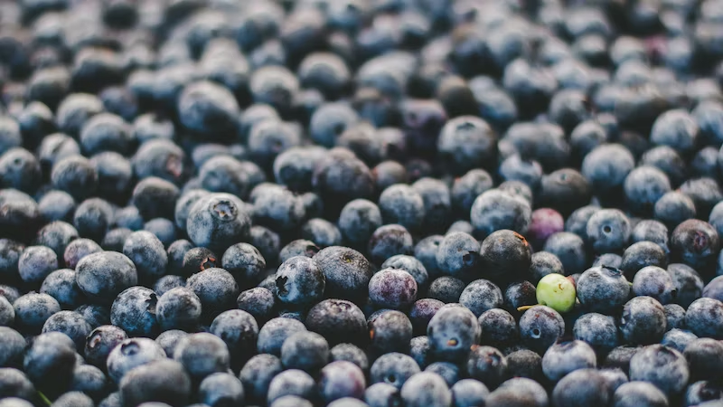
Uniqueness

Slide 2

Start with something
Notes:
Voltaire … Perfection enemy of good.

Slide 3

Crafting Engaging Presentation

Slide 4
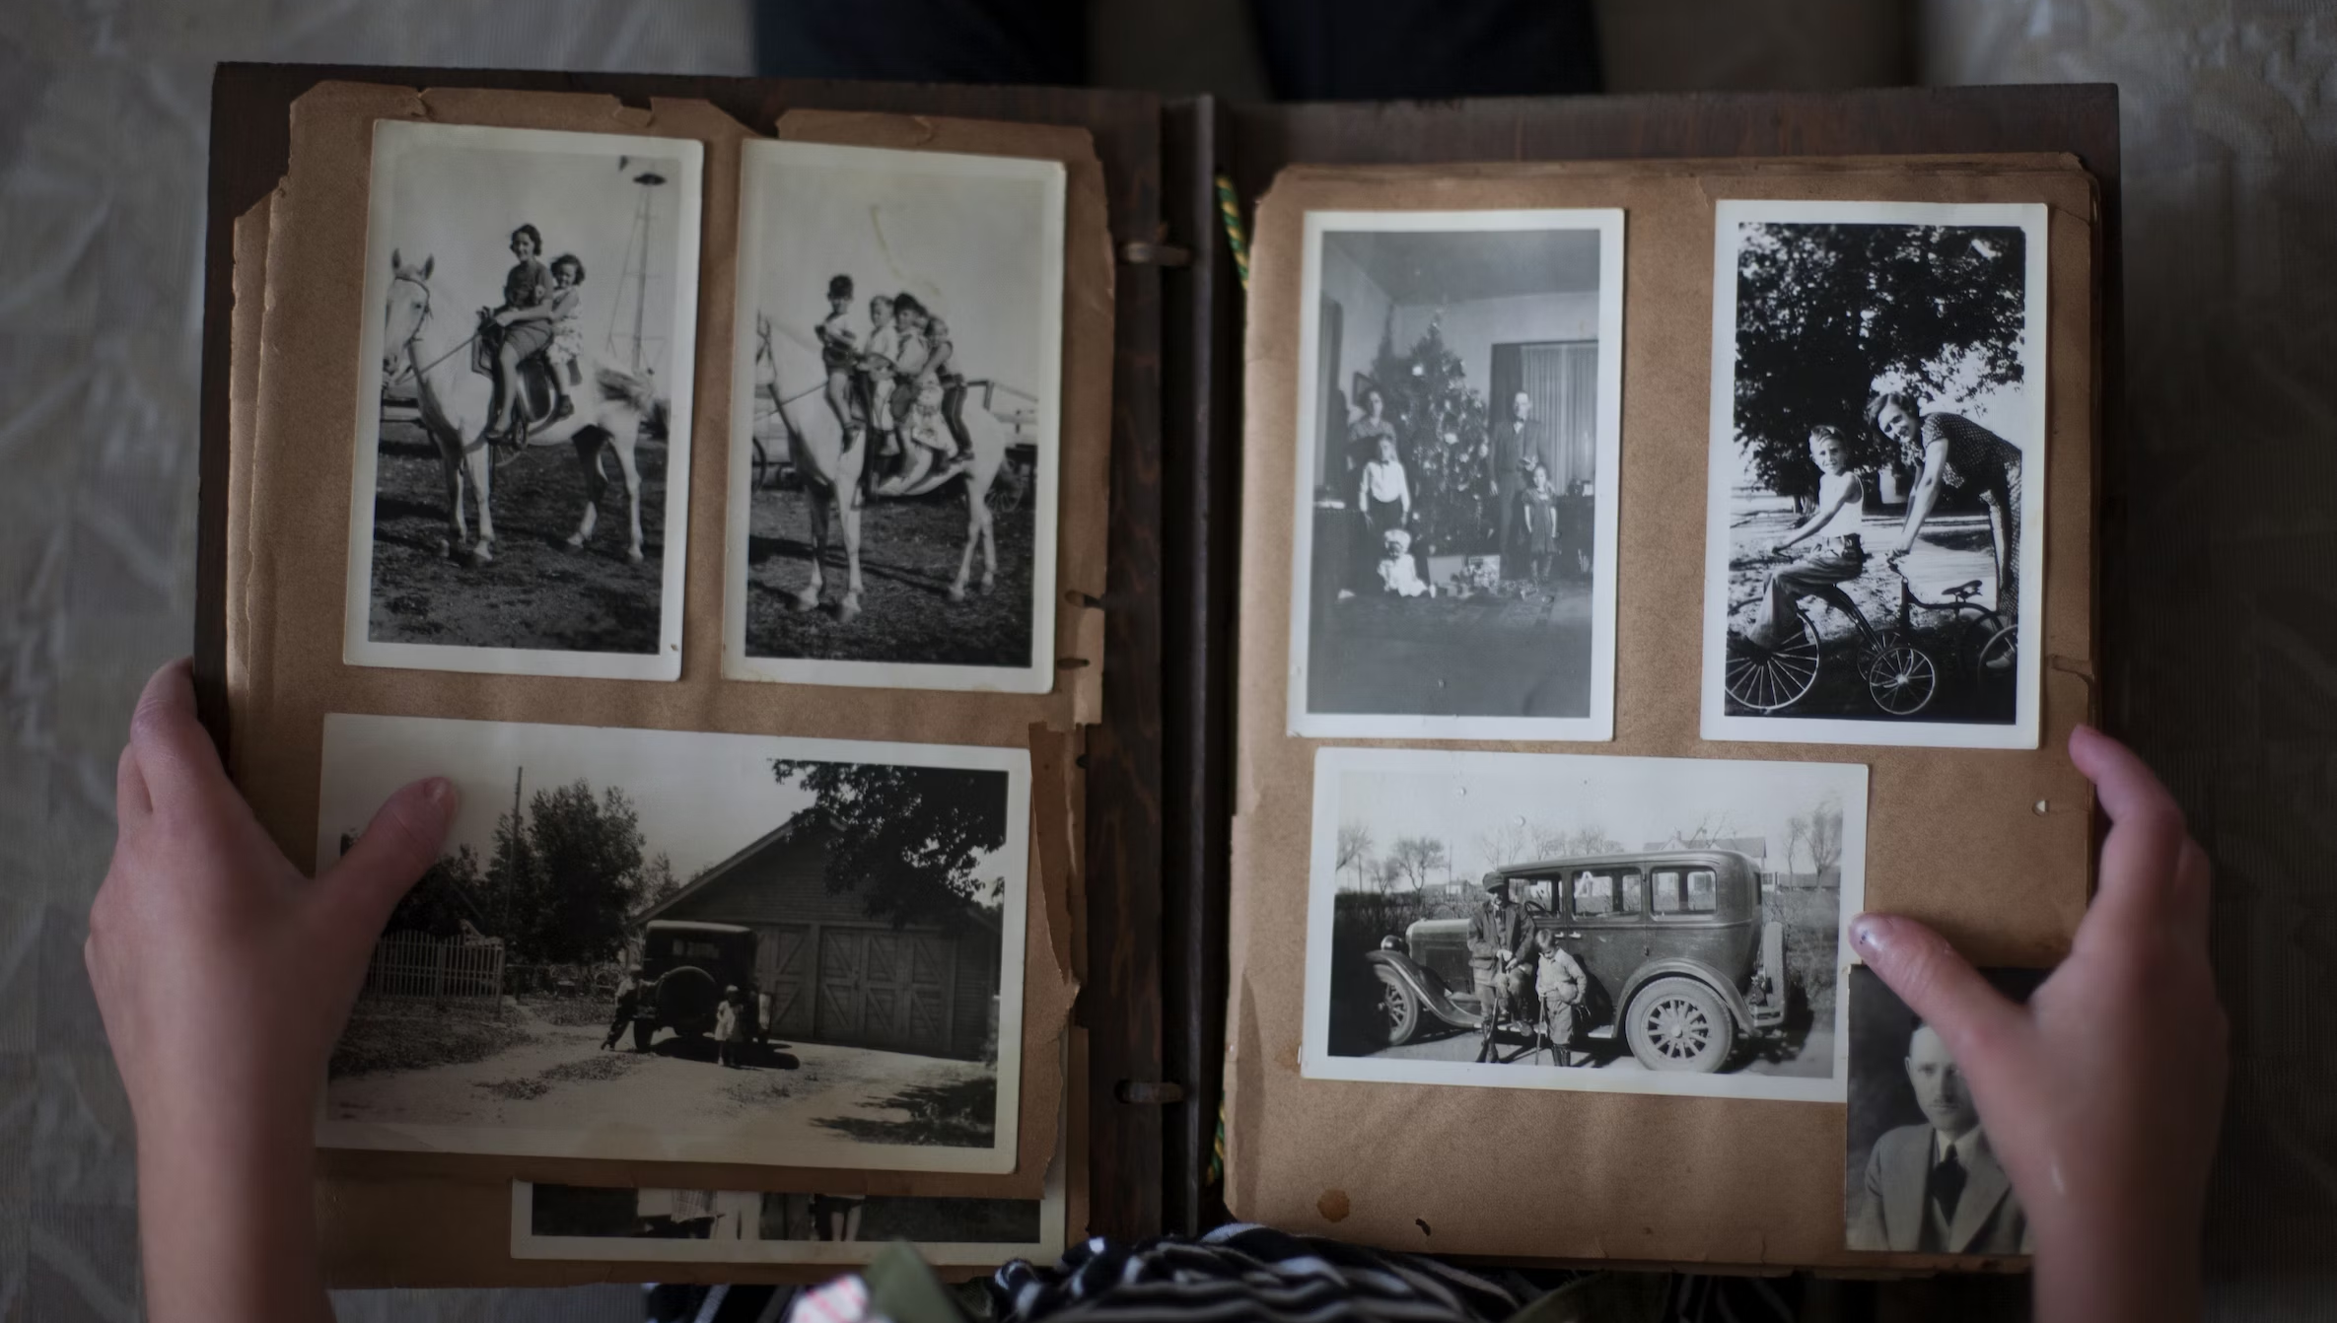
Make it memorable
Notes:
First kiss?

Slide 5
